Slide 1
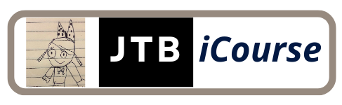
Python Code Structuring
Module 04

Slide 2

Outline
Paired Data Dictionary
Set Implementation
For Loop
Function and Lambda
Scopes
Exception Handling
Comprehension in Python
Modules in Python

Slide 3
Dictionary
The dictionary is an unordered collection that contains key:value pairs separated by commas inside curly brackets.
Dictionaries are optimized to retrieve values when the key is known.
The left side of : is a key, and the right side is a value.
The key should be unique and an immutable object.
A number, string or tuple can be used as key.
A dictionary with a list as a key is not valid, as the list is mutable.

Slide 4
Dictionary
A list can be used as a value.
The same key cannot appear more than once in a collection.
If the key appears more than once, only the last will be retained.
The value can be of any data type.
One value can be assigned to more than one key.
A dictionary can also be created using the dict() constructor method.

Slide 5
Dictionary
Dictionary is an unordered collection, so a value cannot be accessed using an index; instead, a key must be specified in the square brackets.
Use the get() method to retrieve the key's value even if keys are not known.
It returns None if the key does not exist instead of raising an error.
Use the for loop to iterate a dictionary in the Python script.
The key cannot appear more than once.
Use the same key and assign a new value to it to update the dictionary object.
Use a new key and assign a value to it.
The dictionary will show an additional key-value pair in it.

Slide 6
Dictionary
Use the del keyword, pop(), or popitem() methods to delete a pair from a dictionary or the dictionary object itself.
To delete a pair, use its key as a parameter.
To delete a dictionary object, use its name.
The keys() and values() methods return a view objects containing keys and values respectively.
You can check whether a particular key exists in a dictionary collection or not using the in or not in keywords, as shown below.
Note that it only checks for keys not values.

Slide 7
Built-in Dictionary Methods
Dictionary Method | Description
dict.clear() | Removes all the key-value pairs from the dictionary.
dict.copy() | Returns a shallow copy of the dictionary.
dict.fromkeys() | Creates a new dictionary from the given iterable (string, list, set, tuple) as keys and with the specified value.
dict.get() | Returns the value of the specified key.
dict.items() | Returns a dictionary view object that provides a dynamic view of dictionary elements as a list of key-value pairs. This view object changes when the dictionary changes.
dict.keys() | Returns a dictionary view object that contains the list of keys of the dictionary.
dict.pop() | Removes the key and return its value. If a key does not exist in the dictionary, then returns the default value if specified, else throws a KeyError.

Slide 8
Built-in Dictionary Methods
Dictionary Method | Description
dict.popitem() | Removes and return a tuple of (key, value) pair from the dictionary. Pairs are returned in Last In First Out (LIFO) order.
dict.setdefault() | Returns the value of the specified key in the dictionary. If the key not found, then it adds the key with the specified defaultvalue. If the defaultvalue is not specified then it set None value.
dict.update() | Updates the dictionary with the key-value pairs from another dictionary or another iterable such as tuple having key-value pairs.
dict.values() | Returns the dictionary view object that provides a dynamic view of all the values in the dictionary. This view object changes when the dictionary changes.

Slide 9

Simulation [13]
Filename Format: Simulation Day Number + Underscore + Name Initial
Sample: SimulationDay04-13_JTB.py

Slide 10

Let’s work on the problem set!!!
Filename Format: Problem Set Number + Underscore + Name Initial
Sample: PS13_JTB.py

Slide 11
Python - Set
A set is a mutable collection of distinct hashable objects, same as the list and tuple.
It is an unordered collection of objects, meaning it does not record element position or order of insertion and so cannot access elements using indexes.
The set is a Python implementation of the set in Mathematics.
A set object has suitable methods to perform mathematical set operations like union, intersection, difference, etc.
A set object contains one or more items, not necessarily of the same type, which are separated by a comma and enclosed in curly brackets {}.

Slide 12
Python - Set
A set doesn't store duplicate objects. Even if an object is added more than once inside the curly brackets, only one copy is held in the set object. Hence, indexing and slicing operations cannot be done on a set object.
The order of elements in the set is not necessarily the same as the order given at the time of assignment. Python optimizes the structure of a set for performing operations over it, as defined in mathematics.
Even though mutable objects are not stored in a set, the set itself is a mutable object. Use the set() function to create an empty set. Empty curly braces will create an empty dictionary instead of an empty set.
The set() function also use to convert string, tuple, or dictionary object to a set object.
Use built-in set functions add(), remove() or update() methods to modify set collection.

Slide 13
Set Operations
Operator | Example in Python Shell
Union: Returns a new set with elements from both the sets. Operator: | Method: set.union() | s1={1,2,3,4,5} s2={4,5,6,7,8} s1|s2 #{1, 2, 3, 4, 5, 6, 7, 8} s1={1,2,3,4,5} s2={4,5,6,7,8} s1.union(s2) #{1, 2, 3, 4, 5, 6, 7, 8} s2.union(s1) #{1, 2, 3, 4, 5, 6, 7, 8}
Intersection: Returns a new set containing elements common to both sets. Operator: & Method: set.intersection() | s1={1,2,3,4,5} s2={4,5,6,7,8} s1&s2 #{4, 5} s2&s1 #{4, 5} s1={1,2,3,4,5} s2={4,5,6,7,8} s1.intersection(s2) #{4, 5} s2.intersection(s1) #{4, 5}

Slide 14
Set Operations
Operator | Example in Python Shell
Difference: Returns a set containing elements only in the first set, but not in the second set. Operator: - Method: set.difference() | s1={1,2,3,4,5} s2={4,5,6,7,8} s1-s2 #{1, 2, 3} s2-s1 #{8, 6, 7} s1={1,2,3,4,5} s2={4,5,6,7,8} s1.difference(s2) #{1, 2, 3} s2.difference(s1) #{8, 6, 7}

Slide 15
Set Operations
Operator | Example in Python Shell
Symmetric Difference: Returns a set consisting of elements in both sets, excluding the common elements. Operator: ^ Method: set.symmetric_difference() | s1={1,2,3,4,5} s2={4,5,6,7,8} s1^s2 #{1, 2, 3, 6, 7, 8} s2^s1 #{1, 2, 3, 6, 7, 8} s1={1,2,3,4,5} s2={4,5,6,7,8} s1.symmetric_difference(s2) #{1, 2, 3, 6, 7, 8} s2.symmetric_difference(s1) #{1, 2, 3, 6, 7, 8}

Slide 16
Set Methods
Method | Description
set.add() | Adds an element to the set. If an element is already exist in the set, then it does not add that element.
set.clear() | Removes all the elements from the set.
set.copy() | Returns a shallow copy of the set.
set.difference() | Returns the new set with the unique elements that are not in the another set passed as a parameter.
set.difference_update() | Updates the set on which the method is called with the elements that are common in another set passed as an argument.
set.discard() | Removes a specific element from the set.
set.intersection() | Returns a new set with the elements that are common in the given sets.

Slide 17
Set Methods
Method | Description
set.intersection_update() | Updates the set on which the instersection_update() method is called, with common elements among the specified sets.
set.isdisjoint() | Returns true if the given sets have no common elements. Sets are disjoint if and only if their intersection is the empty set.
set.issubset() | Returns true if the set (on which the issubset() is called) contains every element of the other set passed as an argument.
set.pop() | Removes and returns a random element from the set.
set.remove() | Removes the specified element from the set. If the specified element not found, raise an error.
set.symmetric_difference() | Returns a new set with the distinct elements found in both the sets.

Slide 18
Set Methods
Method | Description
set.symmetric_difference_update() | Updates the set on which the instersection_update() method called, with the elements that are common among the specified sets.
set.union() | Returns a new set with distinct elements from all the given sets.
set.update() | Updates the set by adding distinct elements from the passed one or more iterables.

Slide 19
Simulation [14]
Filename Format: Simulation Day Number + Underscore + Name Initial
Sample: SimulationDay04-14_JTB.py

Slide 20
Let’s work on the problem set!!!
Filename Format: Problem Set Number + Underscore + Name Initial
Sample: PS14_JTB.py

Slide 21
Python - For Loop
In Python, the for keyword provides a more comprehensive mechanism to constitute a loop.
The for loop is used with sequence types such as list, tuple, set, range, etc.
The body of the for loop is executed for each member element in the sequence.
Hence, it doesn't require explicit verification of a boolean expression controlling the loop (as in the while loop).
The object of any Python sequence data type can be iterated using the for statement.
The key-value pairs can be unpacked into two variables in the for loop to get the key and value separately.

Slide 22
Python - For Loop
The range class is an immutable sequence type.
The range() returns the range object that can be used with the for loop.
The execution of the for loop can be stop and exit using the break keyword on some condition.
Use the continue keyword to skip the current execution and continue on the next iteration using the continue keyword on some condition.
The else block can follow the for loop, which will be executed when the for loop ends.
If a loop (for loop or while loop) contains another loop in its body block, we say that the two loops are nested.
If the outer loop is designed to perform m iterations and the inner loop is designed to perform n repetitions, the body block of the inner loop will get executed m X n times.

Slide 23
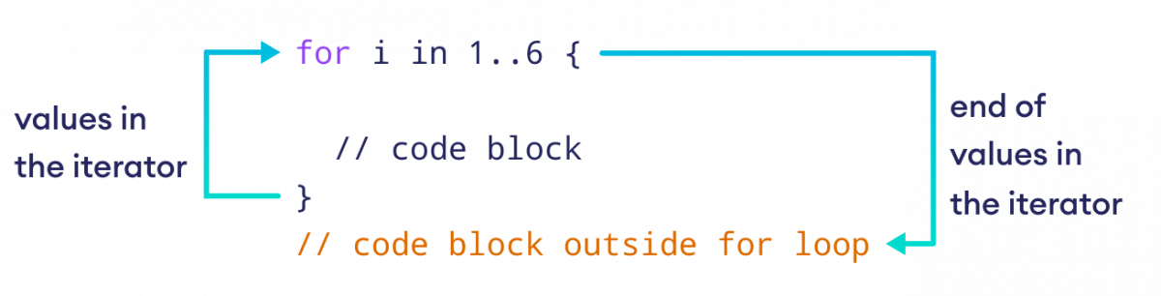
Python - For Loop
For Syntax:
for x in sequence:
statement1
statement2
…..
statementN

Slide 24
Simulation [15]
Filename Format: Simulation Day Number + Underscore + Name Initial
Sample: SimulationDay04-15_JTB.py

Slide 25
Let’s work on the problem set!!!
Filename Format: Problem Set Number + Underscore + Name Initial
Sample: PS15_JTB.py

Slide 26

Trainer’s Tips 07:
MODIFY AS NEEDED
"Modify as needed" in the context of conducting a Python training session refers to the flexibility and adaptability of the training material and the delivery process. It implies the ability and willingness to make adjustments, alterations, or changes to the training content, pace, style, or structure based on the participants' comprehension level, engagement, and individual learning requirements.

Slide 27
Python - Function
Python includes many built-in functions.
These functions perform a predefined task and can be called upon in any program, as per requirement.
However, if you don't find a suitable built-in function to serve your purpose, you can define one.
A function is a reusable block of programming statements designed to perform a certain task.
To define a function, Python provides the def keyword.

Slide 28
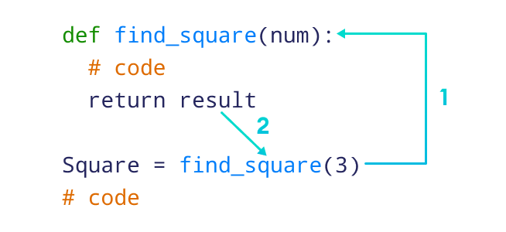
Python - Function
Function Syntax:
def function_name(parameters):
statement1
statement2
…..
statementN
return [expr]

Slide 29
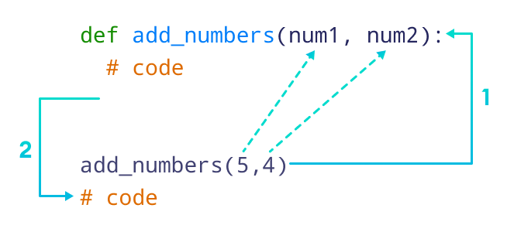
Python - Function
Function Syntax:
def function_name(parameters):
statement1
statement2
…..
statementN
return [expr]

Slide 30
Python - Function
The keyword def is followed by a suitable identifier as the name of the function and parentheses.
One or more parameters may be optionally mentioned inside parentheses.
The : symbol after parentheses starts an indented block.
The first statement in the function body can be a string, which is called the docstring.
It explains the functionality of the function/class.
The docstring is not mandatory.
The function body contains one or more statements that perform some actions. It can also use pass keyword.

Slide 31
Python - Function
Optionally, the last statement in the function block is the return statement.
It sends an execution control back to calling the environment.
If an expression is added in front of return, its value is also returned to the calling code.
To call a defined function, just use its name as a statement anywhere in the code.
By default, all the functions return None if the return statement does not exist.

Slide 32
Python - Function
It is possible to define a function to receive one or more parameters (also called arguments) and use them for processing inside the function block.
Parameters/arguments may be given suitable formal names.
The names of the arguments used in the definition of the function are called formal arguments/parameters.
Objects actually used while calling the function are called actual arguments/parameters.
The function parameters can have an annotation to specify the type of the parameter using parameter:type syntax.

Slide 33
Python - Function
A function can have multiple parameters.
A function in Python can have an unknown number of arguments by putting * before the parameter if you don't know the number of arguments the user is going to pass.
In order to call a function with arguments, the same number of actual arguments must be provided.
A function can be called by passing parameter values using the parameter names in any order.

Slide 34
Python - Function
The function can have a single parameter prefixed with **.
This type of parameter initialized to a new ordered mapping receiving any excess keyword arguments, defaulting to a new empty mapping of the same type.
When using the ** parameter, the order of arguments does not matter.
However, the name of the arguments must be the same.
Access the value of keyword arguments using paramter_name['keyword_argument'].

Slide 35
Python - Function
While defining a function, its parameters may be assigned default values.
This default value gets substituted if an appropriate actual argument is passed when the function is called.
However, if the actual argument is not provided, the default value will be used inside the function.
Most of the time, we need the result of the function to be used in further processes.
Hence, when a function returns, it should also return a value.
A user-defined function can also be made to return a value to the calling environment by putting an expression in front of the return statement.
In this case, the returned value has to be assigned to some variable.

Slide 36
Simulation [16]
Filename Format: Simulation Day Number + Underscore + Name Initial
Sample: SimulationDay04-16_JTB.py

Slide 37
Let’s work on the problem set!!!
Filename Format: Problem Set Number + Underscore + Name Initial
Sample: PS16_JTB.py

Slide 38
Variable Scope in Python
In general, a variable that is defined in a block is available in that block only.
It is not accessible outside the block.
Such a variable is called a local variable. Formal argument identifiers also behave as local variables.
Any variable present outside any function block is called a global variable.
Its value is accessible from inside any function.
However, if we assign another value to a globally declared variable inside the function, a new local variable is created in the function's namespace.
This assignment will not alter the value of the global variable.

Slide 39
Variable Scope in Python
If you need to access and change the value of the global variable from within a function, this permission is granted by the global keyword.
It is also possible to use a global and local variable with the same name simultaneously.
Built-in function globals() returns a dictionary object of all global variables and their respective values.
Using the name of the variable as a key, its value can be accessed and modified.

Slide 40
Simulation [17]
Filename Format: Simulation Day Number + Underscore + Name Initial
Sample: SimulationDay04-17_JTB.py

Slide 41
Let’s work on the problem set!!!
Filename Format: Problem Set Number + Underscore + Name Initial
Sample: PS17_JTB.py

Slide 42
Exception Handling in Python
The cause of an exception is often external to the program itself.
For example, an incorrect input, a malfunctioning IO device etc.
Because the program abruptly terminates on encountering an exception, it may cause damage to system resources, such as files.
Hence, the exceptions should be properly handled so that an abrupt termination of the program is prevented.
Python uses try and except keywords to handle exceptions.
Both keywords are followed by indented blocks.

Slide 43
Exception Handling in Python
The try: block contains one or more statements which are likely to encounter an exception.
If the statements in this block are executed without an exception, the subsequent except: block is skipped.
If the exception does occur, the program flow is transferred to the except: block.
The statements in the except: block are meant to handle the cause of the exception appropriately.
For example, returning an appropriate error message.

Slide 44
Exception Handling (multiple except)
You can specify the type of exception after the except keyword.
The subsequent block will be executed only if the specified exception occurs.
There may be multiple except clauses with different exception types in a single try block.
If the type of exception doesn't match any of the except blocks, it will remain unhandled and the program will terminate.
The rest of the statements after the except block will continue to be executed, regardless if the exception is encountered or not.

Slide 45
Exception Handling (multiple except)
You can mention a specific type of exception in front of the except keyword.
The subsequent block will be executed only if the specified exception occurs.
There may be multiple except clauses with different exception types in a single try block.
If the type of exception doesn't match any of the except blocks, it will remain unhandled and the program will terminate.

Slide 46
Exception Handling (else and finally)
In Python, keywords else and finally can also be used along with the try and except clauses.
While the except block is executed if the exception occurs inside the try block, the else block gets processed if the try block is found to be exception free.
The finally block consists of statements which should be processed regardless of an exception occurring in the try block or not.
As a consequence, the error-free try block skips the except clause and enters the finally block before going on to execute the rest of the code.
If, however, there's an exception in the try block, the appropriate except block will be processed, and the statements in the finally block will be processed before proceeding to the rest of the code.

Slide 47
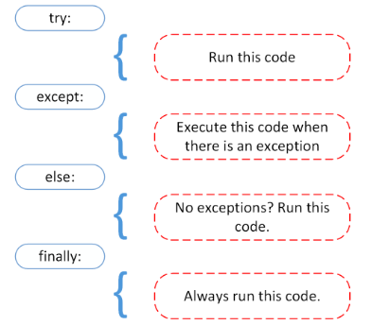
Syntax for Exception Handling
Syntax:
try:
#statements in try block
except:
#executed when error in try block
else:
#executed if try block is error-free
finally:
#executed irrespective of exception occurred or not

Slide 48
Raise an Exception
Python also provides the raise keyword to be used in the context of exception handling.
It causes an exception to be generated explicitly. Built-in errors are raised implicitly.
However, a built-in or custom exception can be forced during execution.

Slide 49
Simulation [18]
Filename Format: Simulation Day Number + Underscore + Name Initial
Sample: SimulationDay04-18_JTB.py

Slide 50
Let’s work on the problem set!!!
Filename Format: Problem Set Number + Underscore + Name Initial
Sample: PS18_JTB.py

Slide 51
Python - List Comprehension
List comprehension in Python is an easy and compact syntax for creating a list from a string or another list.
It is a very concise way to create a new list by performing an operation on each item in the existing list.
List comprehension is considerably faster than processing a list using the for loop.

Slide 52
Python - List Comprehension
The list comprehension syntax contains three parts: an expression, one or more for loop, and optionally, one or more if conditions.
The list comprehension must be in the square brackets [].
The result of the first expression will be stored in the new list.
The for loop is used to iterate over the iterable object that optionally includes the if condition.

Slide 53
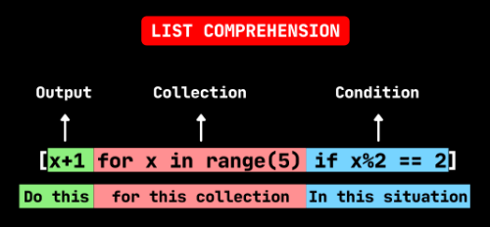
List Comprehension Syntax
Syntax:
[expression for element in iterable if condition]

Slide 54
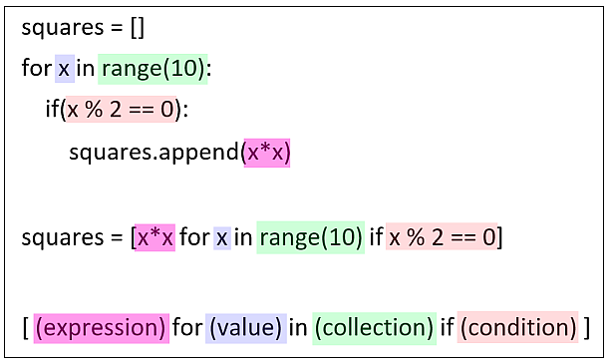
List Comprehension Syntax
With and without list comprehension

Slide 55
Python - List Comprehension
It is possible to use nested loops in a list comprehension expression.
We can use nested if conditions with a list comprehension.
One of the applications of list comprehension is to flatten a list comprising of multiple lists into a single list.

Slide 56
Simulation [19]
Filename Format: Simulation Day Number + Underscore + Name Initial
Sample: SimulationDay04-19_JTB.py

Slide 57
Let’s work on the problem set!!!
Filename Format: Problem Set Number + Underscore + Name Initial
Sample: PS19_JTB.py

Slide 58
Python Modules
Any text file with the .py extension containing Python code is basically a module.
Different Python objects such as functions, classes, variables, constants, etc., defined in one module can be made available to an interpreter session or another Python script by using the import statement.

Slide 59
Python Modules
Functions defined in built-in modules need to be imported before use.
On similar lines, a custom module may have one or more user-defined Python objects in it.
These objects can be imported in the interpreter session or another script.

Slide 60
Python Modules
If the programming algorithm requires defining a lot of functions and classes, they are logically organized in modules.
One module stores classes, functions and other resources of similar relevance.
Such a modular structure of the code makes it easy to understand, use and maintain.
Every module, either built-in or custom made, is an object of a module class.
Use the as keyword to rename the imported module

Slide 61
Simulation [20]
Filename Format: Simulation Day Number + Underscore + Name Initial
Sample: SimulationDay04-20_JTB.py

Slide 62
Let’s work on the problem set!!!
Filename Format: Problem Set Number + Underscore + Name Initial
Sample: PS20_JTB.py

Slide 63

Trainer’s Tips 08:
ENGAGE EFFECTIVELY
"Engaging effectively" in the context of conducting and delivering content in a Python training session refers to the ability of the trainer to actively involve participants and maintain their interest, focus, and participation throughout the training. It encompasses various strategies to capture the learners' attention, encourage their involvement, and ensure their active engagement with the learning material.

Slide 64
Sources:
https://www.python.org/downloads/
https://youtu.be/i-MuSAwgwCU
https://classroom.google.com/c/NTE5NzI3NDA3NTU1/m/NjA4MjI3MDEwMTc5/details
https://youtu.be/VC13MkENVoY
https://youtu.be/GenKovl05YU
https://youtu.be/riL_xn6BKD8
https://youtu.be/_uQrJ0TkZlc
https://docs.python.org/3/tutorial/index.html
https://www.pythontutorial.net/
https://www.programiz.com/python-programming
https://www.tutorialsteacher.com/python
https://www.tutorialspoint.com/python/index.htm
https://www.w3schools.com/python/
https://www.onlinegdb.com/
https://improveandrepeat.com/2020/07/python-friday-30-list-comprehension/
https://intellipaat.com/blog/tutorial/python-tutorial/?US

Slide 65
Thank you…

